Slide 1

DATA ANALYSIS – GOLD ATLANTIS
Presented by : Apoorva Mishra

Slide 2




OBJECTIVE : To find the type of customers who are efficient in repayment of loan and are non defaulters.
THE FACTORS USED FOR THE ANALYSIS ARE AS FOLLOWS:
Whether the customer has defaulted in repayment in the past.
Type of income
Educational background
Whether there was any guarantor for the customer
How many dependents are there of the defaulter
Gender
Assets
Income and credit

Slide 3
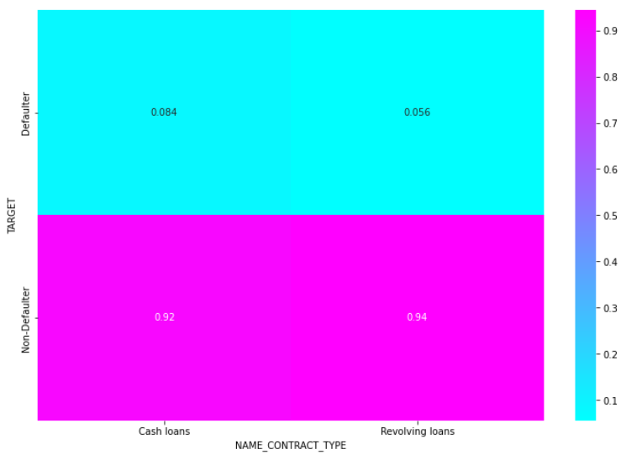

Target and Name Contract Type analysis
Customer who opted for Revolving loans are more efficient in the repayment of the loan. Whereas customers who have opted to Cash Loans had few difficulties to pay the EMIs on time.

Slide 4
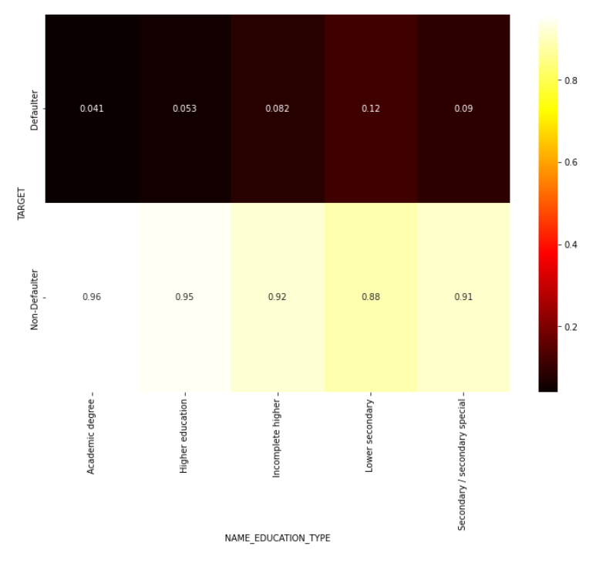

Target and Education Type analysis
People having Academic Degree and unlikely to default(4.1%)
Where as people having Lower secondary type are likely to default (12%)

Slide 5
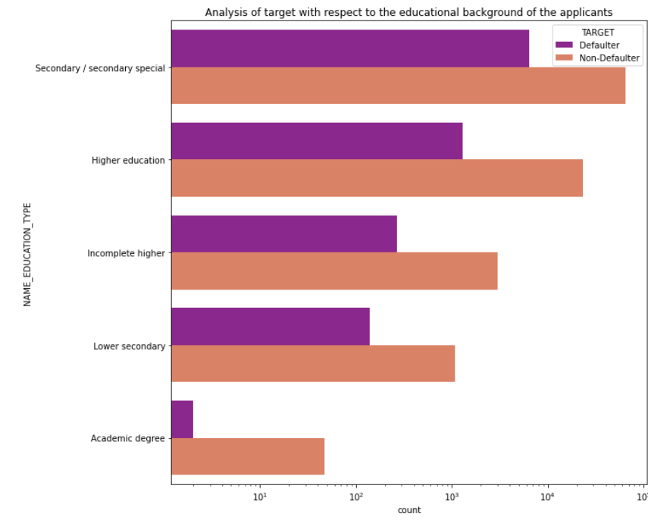
Conclusion:
The person with academic degree is unlikely to default whereas a person with Secondary/ secondary special educational background is more likely to become a defaulter.

Slide 6
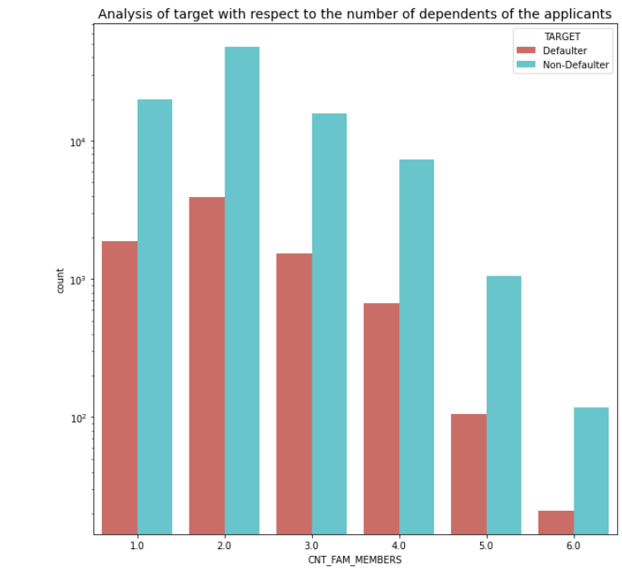
Target and Number of family members
Applicants with family members equal to 2 are more likely to become defaulters as compared to the rest of the applicants.
Applicant with 6 members are least likely to default.

Slide 7
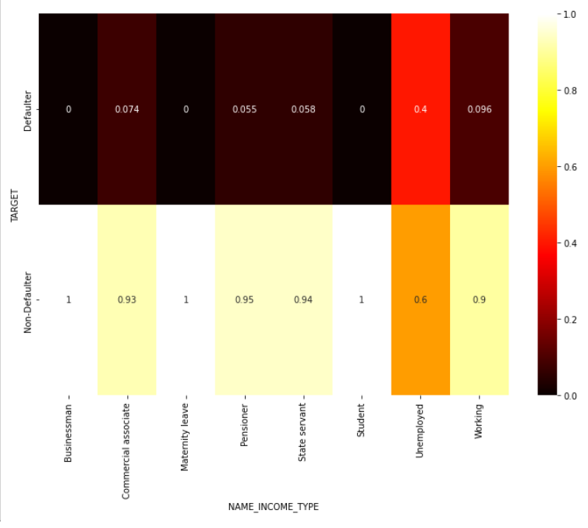
Analysis of Income type of the customer with respect to Target
People who are in the business(100%), Maternity leave(100%) and student(100%) category are highly unlikely to default.
Where as customers who are unemployed(40%) have higher probability to default.

Slide 8
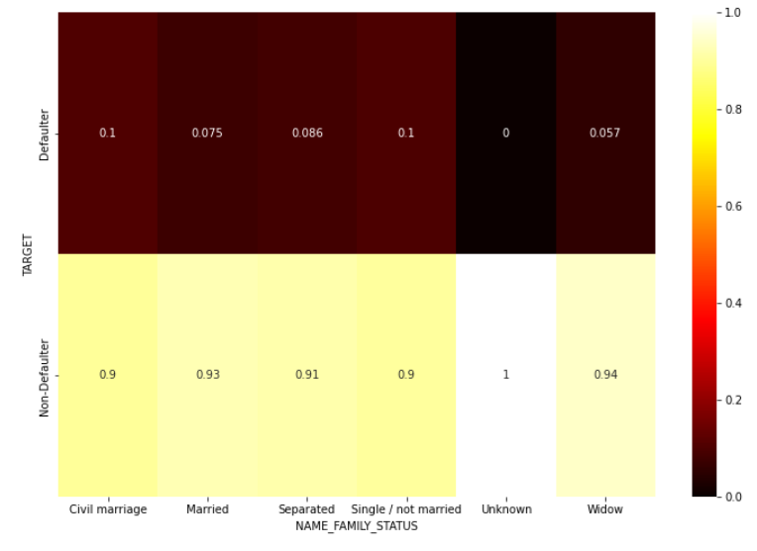

Family status and default analysis
Married applicants and widows have lower rate of defaults.

Slide 9
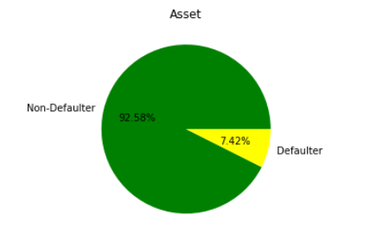
Asset Analysis of Non- Defaulter
92.58% of the customers having both the assets (car and house) are non defaulters. Hence proving that customers having both the assets are less likely to default.

Slide 10
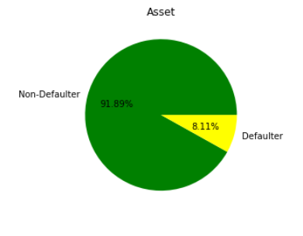
Asset Analysis of Non- Defaulter
91.89% of the customers having either of the assets (car or house) are non defaulters. Hence proving that customers having either of the assets are less likely to default.

Slide 11
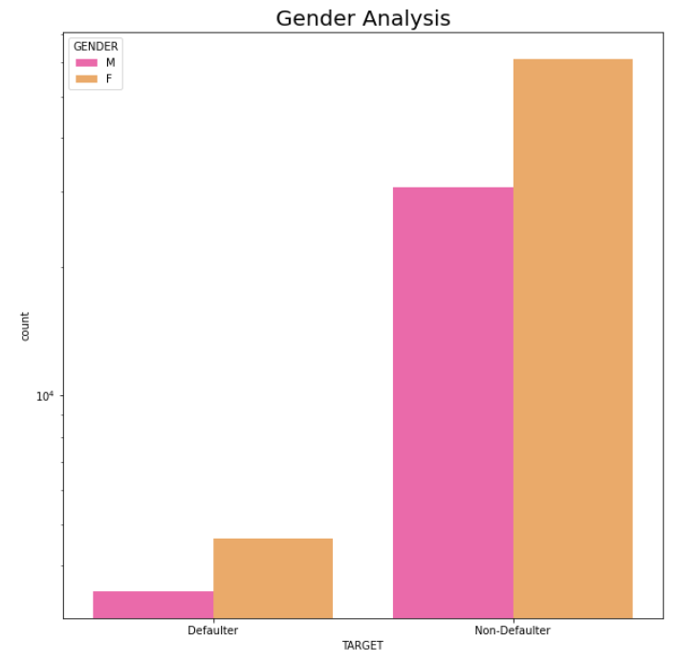
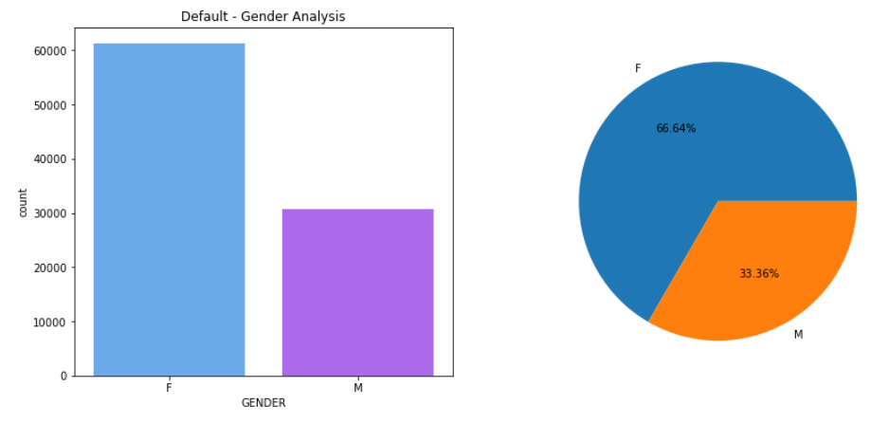
Gender- Target Analysis
Overall more females have been a defaulter compared to males.
Also in the data of the Defaulters Females are more than males

Slide 12
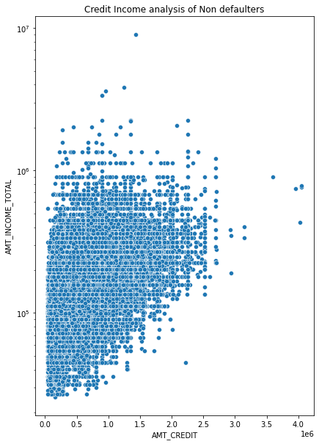
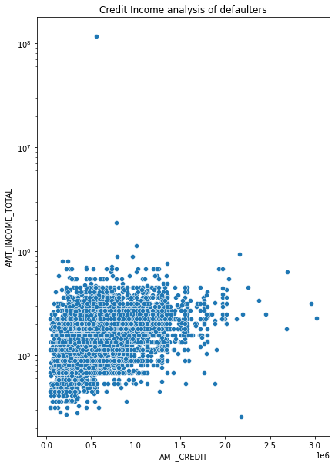
Observation: It is observed that income and credit of the applicant has no effect on whether they will be defaulters or not
The average of the Income-credit ratio of Non Defaulters:
The average of the Income-credit ratio of Defaulters:
mean 0.409605
std 2.328217
min 0.010000
25% 0.200000
50% 0.310000
75% 0.470000
max 208.000000
mean 0.400234
std 0.341115
min 0.020000
25% 0.190000
50% 0.300000
75% 0.500000
max 12.000000

Slide 13
OVER ALL CONCLUSION:
There are less defaults if the loan type is Revolving loan
Person with the academic degree should be preferred
Applicants with income type- Business and student are less likely to default
Applicants having either of the assets or both the assets must be preferred
Applicants who are married have lesser probability to default

Slide 14
THANK YOU !!

